Slide 1


Nexthikes IT Solutions
Exploratory Data Analysis (EDA) for Real Estate Pricing: Unveiling the
Dynamics of House Valuation in a Dynamic Market
PRESENTED BY VIKAS KUMAR

Slide 2
Agenda
Project Tasks :
Loading the Data:
● Task: Load the real estate pricing dataset into a Pandas Data Frame.
● Python Library: Pandas
● Explanation: Load the dataset provided in a CSV or Excel format into a Pandas Data Frame to facilitate easy manipulation and analysis.
2. Cleaning the Data:
● Task: Clean the dataset by handling missing values, removing duplicates, and addressing any anomalies.
● Python Library: Pandas
● Explanation: Ensure data quality by eliminating missing values, removing duplicate entries, and addressing any anomalies or inconsistencies in the dataset.

Slide 3
3. Univariate Analysis:
● Task: Explore individual variables to understand their distributions and characteristics.
● Python Library: Matplotlib, Seaborn
● Explanation: Conduct a univariate analysis to understand the distribution of key variables like house prices. Utilize histograms, kernel density plots, or other visualizations to gain insights into the data
4.Bivariate Analysis
Example 1: Living Area vs Sale Price (Numeric–Numeric)
Variables:
GrLivArea → Living area (sq. ft)
SalePrice → House price
Purpose
To understand how house size affects pric
5. Multivariate Analysis:
● Task: Investigate relationships between multiple variables, especially those impacting house prices.
● Python Library: Matplotlib, Seaborn
● Explanation: Perform multivariate analysis to understand the correlations and dependencies between various features. Utilize techniques like correlation matrices or scatterplot matrices for a comprehensive view.

Slide 4
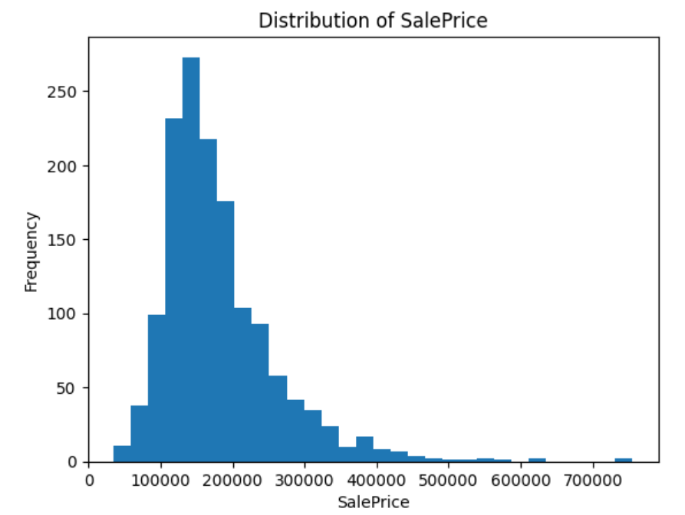
Univariate Analysis¶
Univariate analysis involves the examination of a single variable at a time to understand its distribution, central tendency, spread, and presence of outliers
Example 1: Histogram Plot
##Insight:
Shows skewness
Identifies outliers
Helps check normality

Slide 5
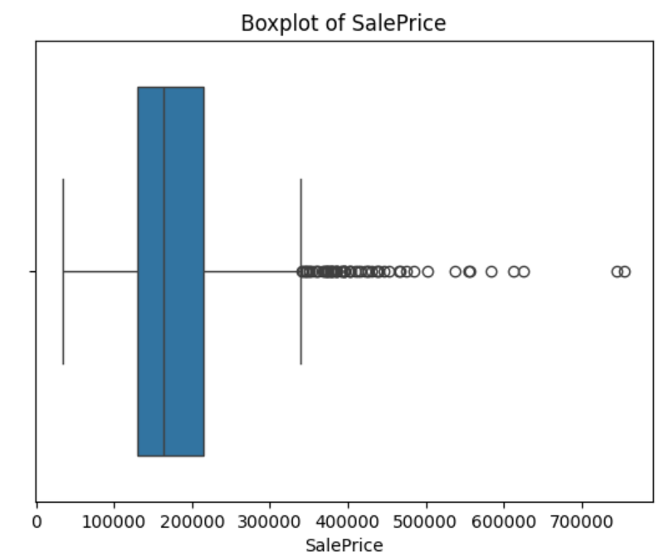
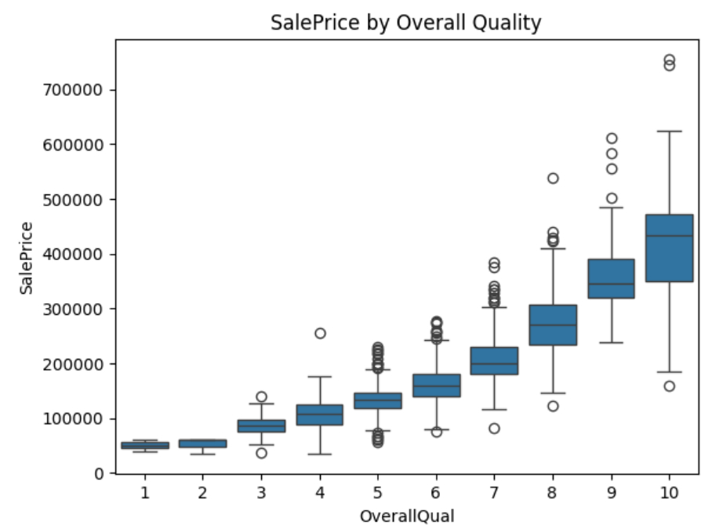
Example 2: Box Plot
##Insight:
Median
Spread (IQR)
Extreme values

Slide 6
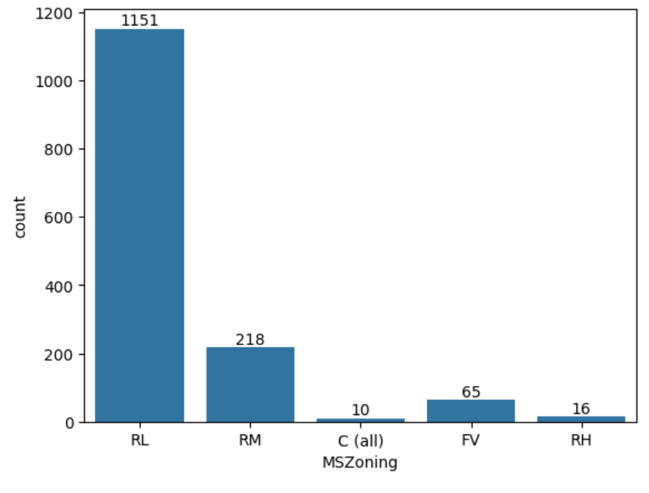
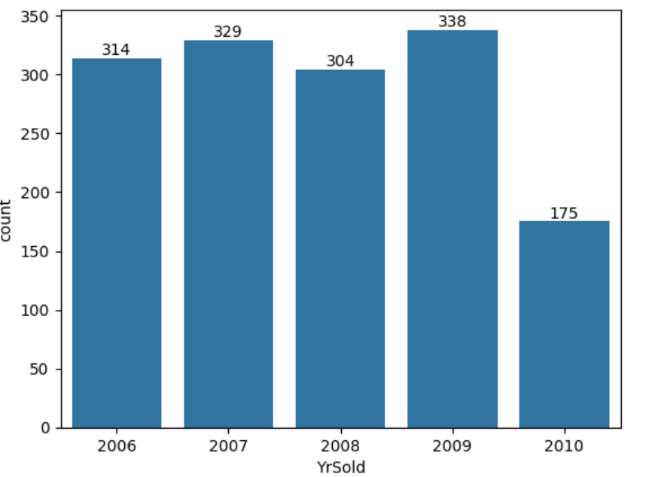
Example 3: Count Plot
2009 recorded the highest number of house sales (338)
2007 also shows high activity with 329 sales
2008 shows a noticeable decline (304 sales) compared to 2007
2010 has the lowest number of sales (175), indicating a sharp drop
Sales activity from 2006 to 2009 remains relatively stable, followed by a steep fall in 2010

Slide 7
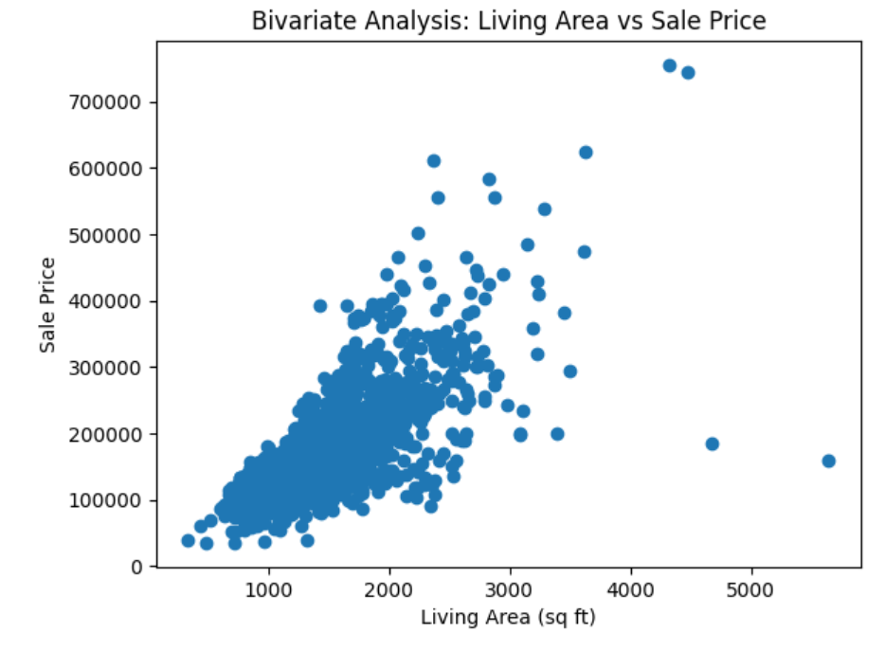
Bivariate Analysis¶
Bivariate analysis examines the relationship between two variables to understand how one variable influences or is associated with another
Example 1: Living Area vs Sale Price (Numeric–Numeric)
Variables:
GrLivArea → Living area (sq. ft)
SalePrice → House price
Purpose
To understand how house size affects price.
##Observation
Strong positive relationship
As living area increases, sale price increases
Conclusion
Living area is a key determinant of house price
Insight:
Linear or non-linear relationship
Correlation direction
Outliers
Scatter Plot

Slide 8
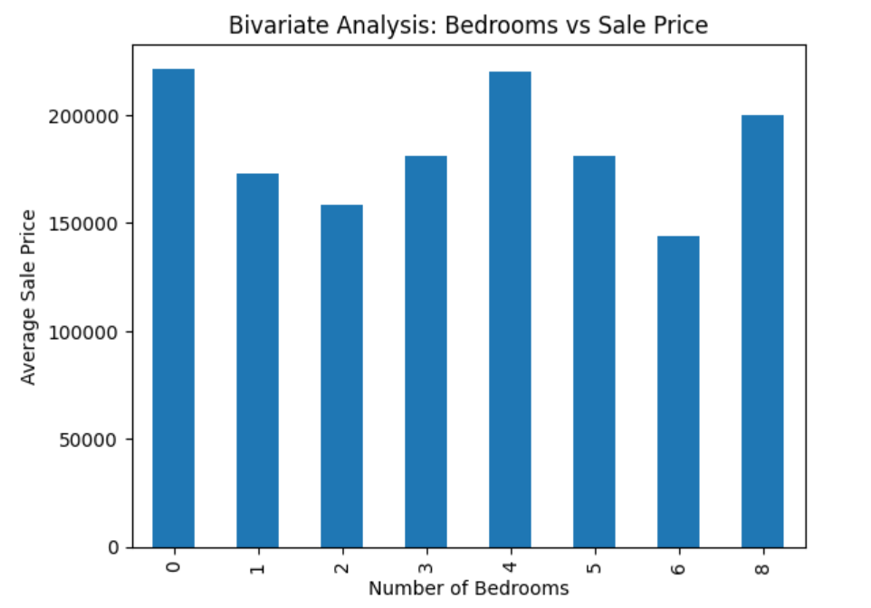
##Example 2: Number of Bedrooms vs Sale Price (Categorical–Numeric)
##Observation
Prices increase with bedrooms up to a point
After that, the increase is marginal
Conclusion
More bedrooms increase value, but with diminishing returns

Slide 9
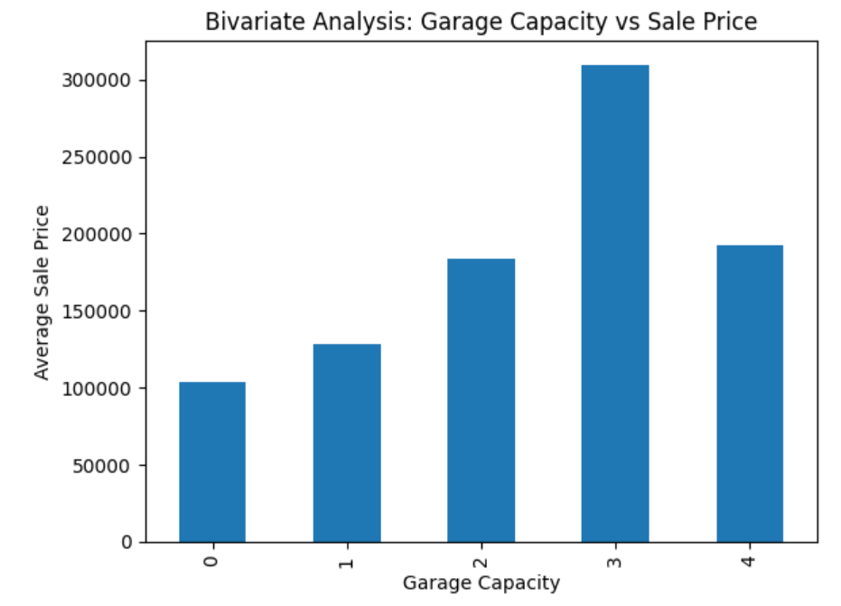
##Example 3: Garage Cars vs Sale Price (Categorical–Numeric)
Variables:
GarageCars → Garage capacity
SalePrice → House price
##Observation
Houses with 2–3 car garages are priced higher
Conclusion
Garage space significantly impacts house valuation
Insight:
Category comparison
Mean trends

Slide 10
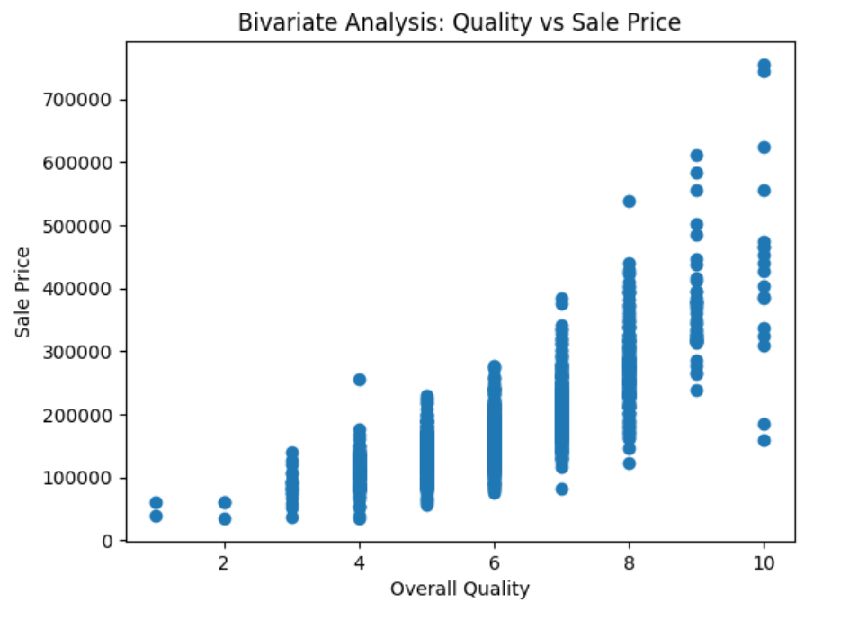
##xample 4: Overall Quality vs Sale Price (Ordinal–Numeric)
Variables:
OverallQual → Quality rating (1–10)
SalePrice → House price
##Observation
Strong upward trend
Higher quality = higher price
Conclusion
Overall quality has a strong positive effect on pricing

Slide 11
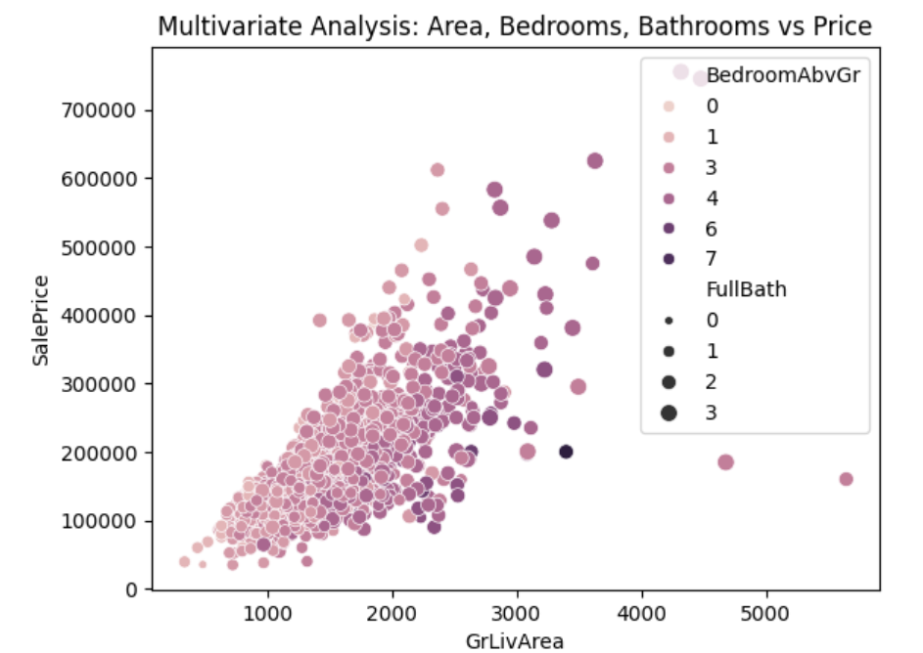
Multivariate analysis¶
##Example 1: Living Area + Bedrooms + Bathrooms vs Sale Price
Variables involved (4 variables):
GrLivArea (size)
BedroomAbvGr (bedrooms)
FullBath (bathrooms)
SalePrice (target)
🔹 Purpose
To understand how multiple house features together influence price.
🔹 Code (Scatter with Color Encoding)
##Observation
Larger houses with more bedrooms and bathrooms are priced higher
Color and size show combined influence
🔹 Conclusion
House price depends on multiple features simultaneously

Slide 12
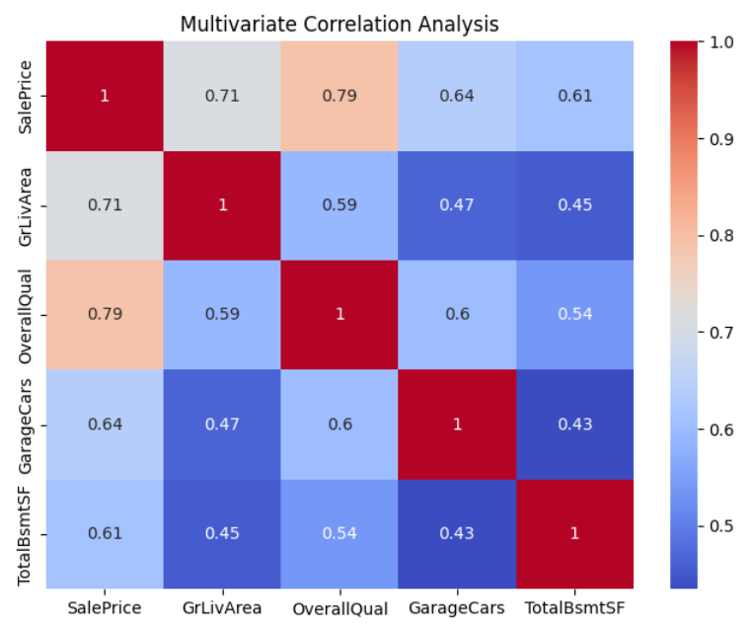
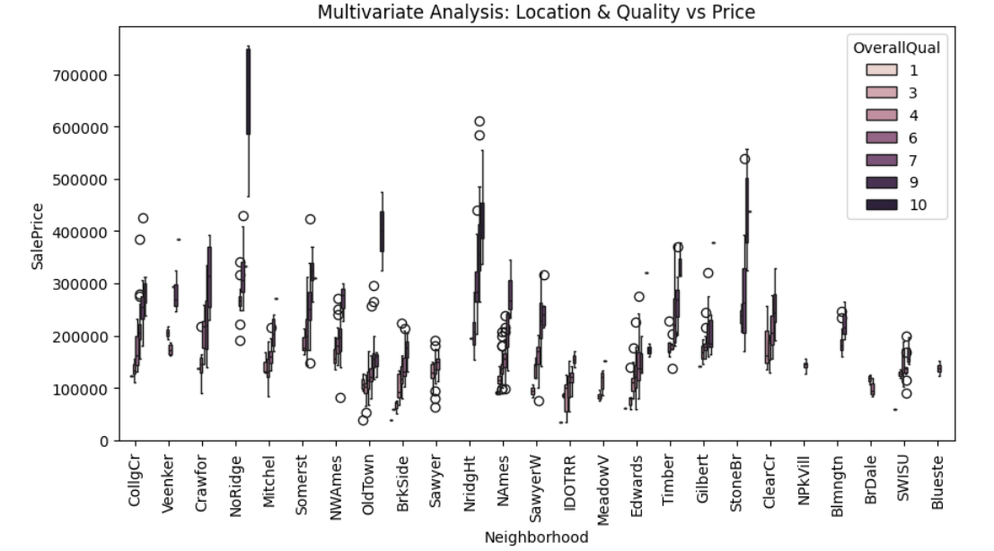
##Example 2: Correlation Heatmap (Multiple Numeric Variables)
Variables:
SalePrice
GrLivArea
OverallQual
GarageCars
TotalBsmtSF
##Observation
Strong correlation between SalePrice and:
OverallQual
GrLivArea
GarageCars
🔹 Conclusion
Multiple variables jointly explain price variation
Insight:
Strength & direction of relationships
Feature selection
##Example 3: Boxplot with Multiple Categories
Variables (3 variables):
SalePrice (numeric)
Neighborhood (categorical)
OverallQual (categorical)

Slide 13
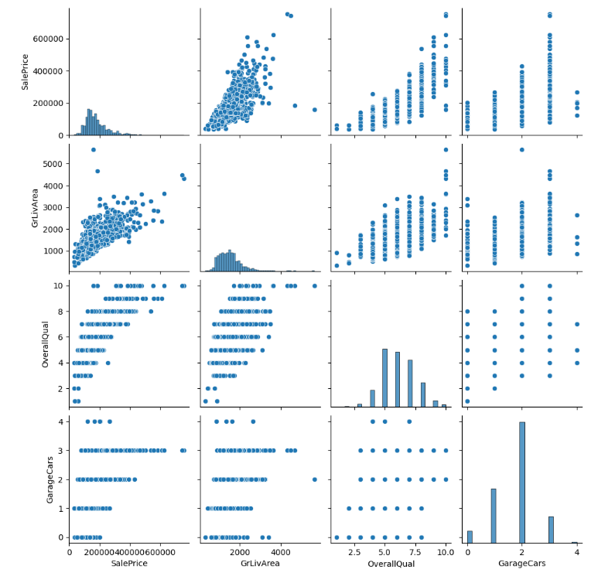
##Example 4: Pair Plot (Classic Multivariate EDA)
1. SalePrice vs GrLivArea
There is a strong positive correlation.
Larger houses (higher GrLivArea) tend to have higher SalePrice.
There are a few outliers with very high GrLivArea but not proportionally high prices.
2. SalePrice vs GarageCars
Houses with more garage spaces tend to have higher SalePrice, but the correlation is weaker than with GrLivArea or OverallQual.
Most houses have 1–3 garage spaces, with very few having 4.

Slide 14
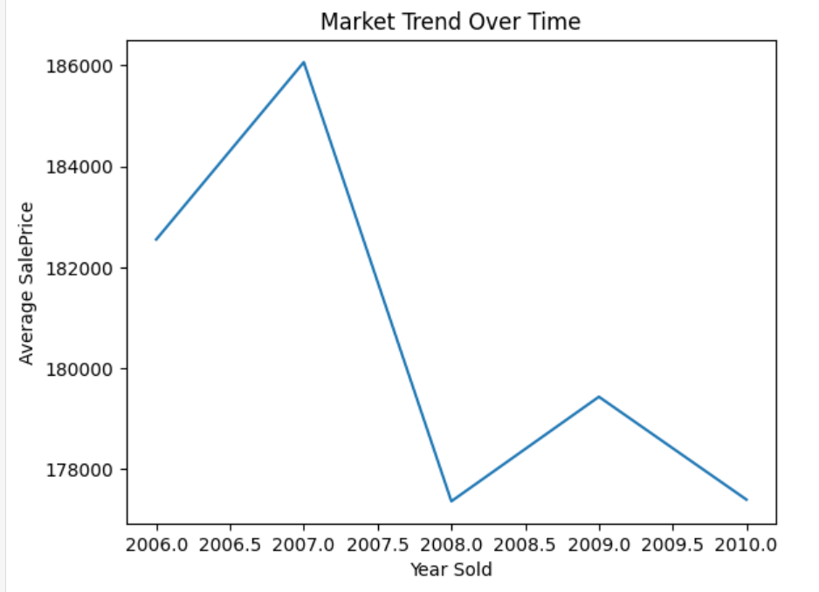
##Example 4: Line Plot (Classic Multivariate EDA)
5. Overall Market Pattern
The trend follows a boom → crash → weak recovery pattern.
High volatility suggests macroeconomic factors dominate price movement more than property-level features in this timeframe.
6. Implications for Analysis & Modeling
YearSold is a meaningful temporal feature and should not be ignored.
Consider:
  Adding time-based dummy variables
  Using trend or interaction terms with OverallQual or GrLivArea
Avoid assuming price stationarity across years.

Slide 15
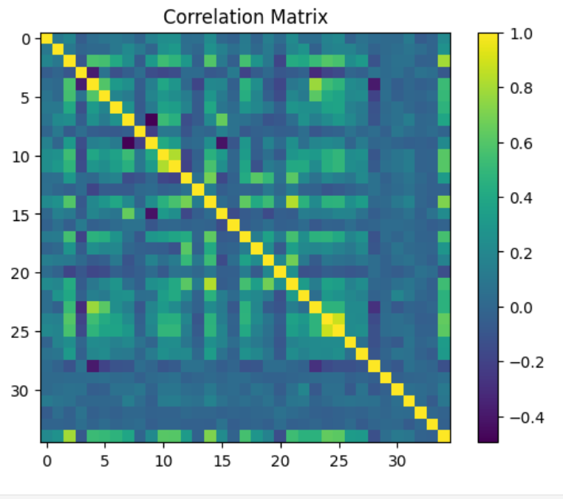

Slide 16
Thank You

